Slide 1
Multimedia: Making it Work
Chapter 08
Video

Slide 2
Video
Using video.
How video works?
Broadcast video standards.
Analog video.
Digital video.

Slide 3
Using Video
Video is an excellent tool for delivering multimedia.
Video places the highest performance demand on computer and its memory and storage.
Digital video has replaced analog as the method of choice for making and delivering video for multimedia.

Slide 4
Using Video
Analog video is a video signal transferred by an analog signal. When combined in to one channel, it is called composite video as is the case, among others with NTSC, PAL and SECAM.
Digital video is a type of digital recording system that works by using a digital rather than an analog video signal. The terms camera, video camera, and camcorder are used interchangeably in this article.
In brief, analog video signals are in the form of waves while digital video signals are in the form of 1s and 0s.

Slide 5
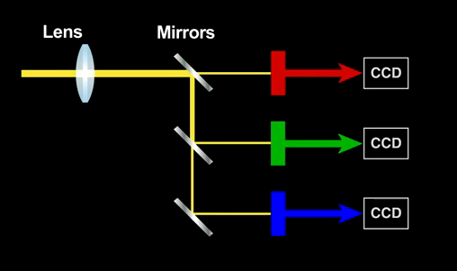
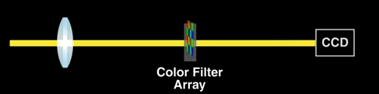
How Video Works
When light reflected from an object passes through the camera’s lens is converted into electronic signal by charge-coupled device (CCD).
Top-quality broadcast cameras and even camcorders may have as many as three CCDs (one for each color of red, green, and blue) to enhance the resolution of the camera and the quality of the image.

Slide 6
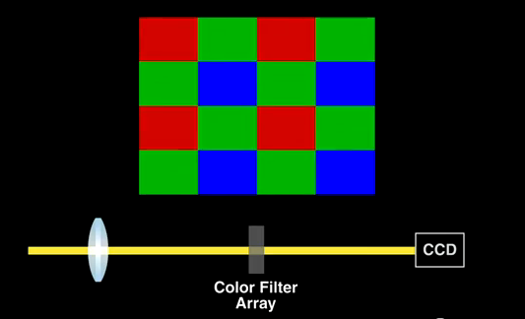
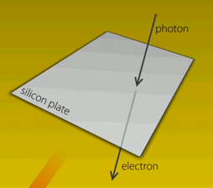
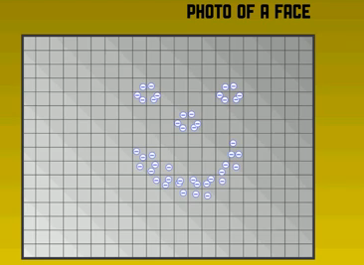
How Video Works

Slide 7
Analog Video
In an analog system, the output of the CCD is processed by the camera into three channels of color information and synchronization pulses (sync) and the signals are recorded onto magnetic tape.
There are several video standards for managing analog CCD output, each dealing with the amount of separation between the components—the more separation of the color information, the higher the quality of the image (and the more expensive the equipment).

Slide 8
Analog Video
Three analog broadcast video standards are commonly in use around the world:
  NTSC,
  PAL,
  and SECAM.

Slide 9
NTSC
National Television Standards Committee (NTSC):
  These standards define a method for encoding information into electronic signal that creates a television picture.
  It has screen resolution of 525 horizontal scan lines and a scan rate of 30 frames per second.

Slide 10
PAL
Phase Alternate Line (PAL)
  PAL has a screen resolution of 625 horizontal lines and a scan rate of 25 frames per second.

Slide 11
SECAM
The Sequential Color and Memory (SECAM)
    SECAM has a screen resolution of 625 horizontal lines and is a 50 Hz system.

Slide 12
Digital Video
In digital systems, the output of the CCD is digitized by the camera into a sequence of single frames, and the video and audio data are compressed before being written to a tape or digitally stored to disc or flash memory in one of several proprietary and competing formats.

Slide 13
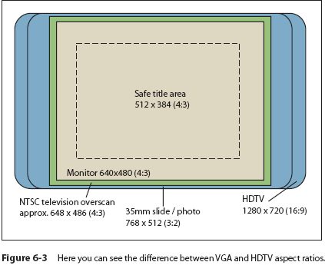
High Definition Television (HDTV)
HDTV provides high resolution in a 16:9 aspect ratio (see Figure 6-3).

Slide 14
High Definition Television (HDTV)
Standard Television STV, providing the NTSC’s resolution of 525 lines with a 3:4 aspect ratio, but in a digital signal) signals or one HDTV signal (providing 1,080 lines of resolution with a movie screen’s 16:9 aspect ratio).

Slide 15
Interlacing and Progressive Scan
The process of building a single frame from two fields is called interlacing, a technique that helps to prevent flicker on CRT screens.
Computer monitors use a different progressive-scan technology, and draw the lines of an entire frame in a single pass, without interlacing them and without flicker.

Slide 16
Interlacing and Progressive Scan
In television, the electron beam actually makes two passes on the screen as it draws a single video frame,
First laying down all the odd-numbered lines, then all the even-numbered lines, as they are interlaced.

Slide 17
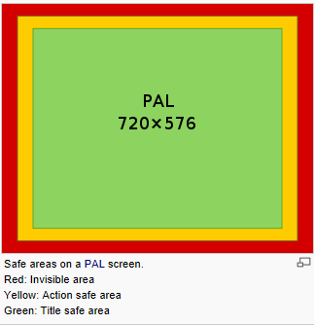
Overscan and the Safe Title Area
Analog television sets remain the most widely installed platforms for delivering and viewing video.
Overscan is extra image area around the four edges of a video image that may not be seen reliably by the viewer. It exists because television sets in the 1930s through 1970s were highly variable in how the video image was framed within the cathode ray tube (CRT).
Overscan occurs when an image is larger than the standard TV screen.

Slide 18
Overscan and the Safe Title Area
Underscan occurs when computer monitors display a smaller image on picture tube.
The safe title area is where the image will not be affected by overscanning, even in the worst conditions.

Slide 19
Digital Video Containers
A digital video architecture is made up of an algorithm for compressing and encoding video and audio, a container in which to put the compressed data, and a player that can recognize and play back those files. Common containers for video are Ogg (.ogg, Theora for video, Vorbis for audio), Flash Video (.flv), MPEG (.mp4), QuickTime (.mov), Windows Media Format (.wmv), WebM (.webm), and RealMedia (.rm).

Slide 20
Digital Video Containers
The QuickTime container, for example, allows inclusion of text tracks, chapter markers, transitions, and even interactive sprites.

Slide 21
Summary
Digital video method is used for making and delivering video for multimedia.
Charge-coupled device (CCD) converts the light that has been reflected from an object through the camera’s lens.
Various video standards are NTSC, PAL, SECAM, and ATSC DTV.

